Slide 1
QA for the Internet Of Things
Andrey Madan
Sr. Solution Architect
TCQAA, Minneapolis
April 13, 2017

Slide 2
Agenda
Intro
Why IoT?
Why learn from IT?
Why learn from Safety Critical Embedded?
IoT Security
Amazon Alexa - demo
Questions and answers

Slide 3
Short intro: Andrey Madan
Novosibirsk State University: Physics / CompSci
Graduated from Purdue in both BS and MS in Computer Science
Medtronic – Firmware Development / Test Automation: ~10 years
Parasoft – Solution Architect / Product Manager: ~4 years
Live in Maple Grove, MN
Wife + two children + one dog

Slide 4
Already on the Market - IoT
Notes:
And wearables of course, but that not really the market.
Iiot is really the thing – scada

Slide 5
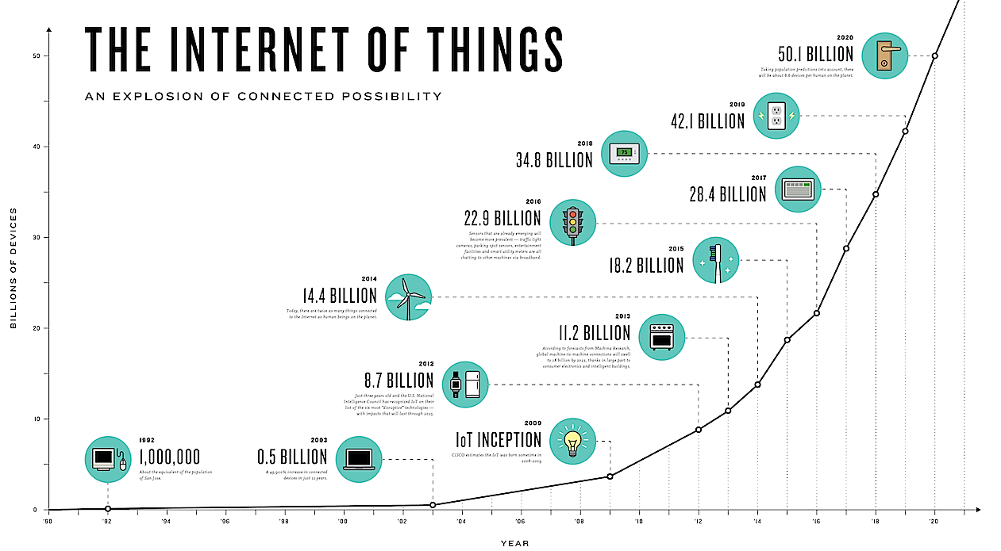

Slide 6
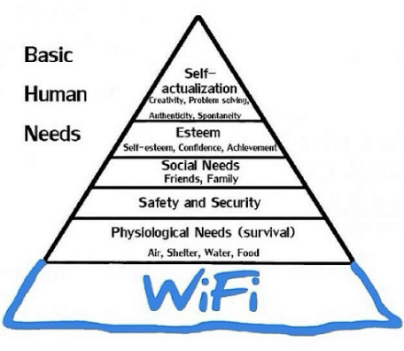
Why QA matter in IoT?
Connected “things” become integral part of our LIFE
Basic Human Needs: Safety & Security -> Quality

Slide 7
Trends in Safety Critical and Embedded
Increasing complexity of embedded systems
Connectivity is a game changer
New trends emerge in automotive, medical, …
Software = 21% of vehicle value
Automotive software market = $10.1B by 2020

Slide 8
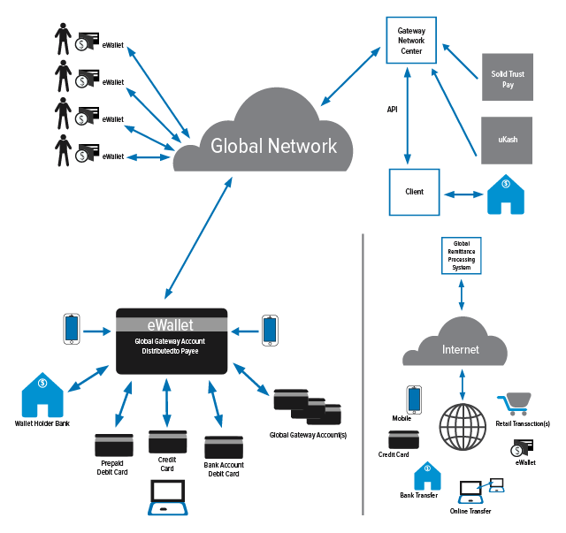
Similarities between Enterprise IT and Embedded/IoT
Functionalities spanning across many layers
Open Architecture
24x7 Connectivity
Constant Security threat

Slide 9
What can Embedded learn from IT?
Enterprise IT solved the problems …
Connected embedded systems resemble architectures known in IT
Complexity stemming from interconnections shifts the gravity in testing
Embedded Left-focus strategy no longer optimal

Slide 10
What can IT learn from Safety Critical Industry?

Slide 11
Development Testing Practices
Static Analysis
Code Reviews
System Reviews
Unit Testing
Requirement Traceability to both Code and Test
Runtime Analysis
Negative and boundary condition testing
Test Environment Validation

Slide 12
Meet in the middle?
Embedded development
Enterprise IT development
Focus on defect prevention and early detection
Unit Testing, Software Coding Guidelines
Minimize testing fully assembled integrated systems
Avoid debugging of integrated systems
Focusing on compliance, not speed
Focus on rapid development
Volume of code too large to widely apply unit testing
Automated component/API level testing
Testing and debugging integrated solutions

Slide 13
Testing Strategy is the key
The right granularity of Unit/Component/API tests
Solidifying automation at the message layer
Gaining access to fresh, realistic, and credible test data
Accessing the distributed environment in order to test continuously

Slide 14
Strategies
Measure, correlate and optimize your testing activities
Test anytime, anywhere with a Virtual Test Bed for entire system
Test for security vulnerabilities at every stage

Slide 15
Measure, correlate and optimize your tests
Assess the quality of functionalities deployed in multiple layers
Automated API tests executed against each layer
Reasonable structure of requirements
Mapping tests to requirements
Understanding tests results in context of requirements

Slide 16
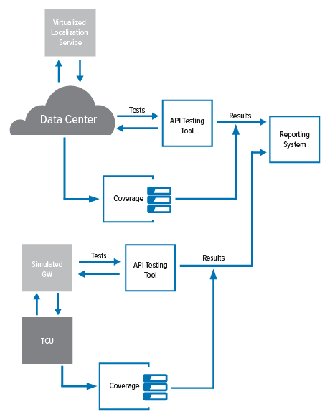
Measure, correlate and optimize your tests
Combining code coverage with structured tests
Using code coverage to assess the testing process
Avoiding weak links in the functionality
Coverage tools supporting multiple technologies
Assess impact of change in the code base

Slide 17
Granular individual test coverage

Slide 18
Aggregated test coverage

Slide 19
Traceability back to requirements
resources.sei.cmu.edu/library/asset-view.cfm?assetid=428589

Slide 20
IoT Security

Slide 21
Shift left security testing
Penetration Testing vs Security Policy
Late cycle, disconnected from dev, costly, cannot test ’every combination’
.. Security needs to be integrated into earlier stages of the SDLC
Leverage functional tests to drive to security vulnerability testing
Reduce the cost of late cycle detection
Trace to the business cases that are impacted
Trace to the underlying code and identify the root causes
Move from ‘detection’ to ‘prevention’ = policy

Slide 22
IoT Software Security
Software security is the idea of engineering software so that it continues to function correctly under malicious attack.
Although the notion of protecting software is an important one, it’s just plain easier to protect something that is defect-free than something riddled with vulnerabilities.
(Gary McGraw, Cigital)
https://buildsecurityin.us-cert.gov/resources/building-security-in/software-security
Notes:
https://buildsecurityin.us-cert.gov/resources/building-security-in/software-security

Slide 23
Security Standards
MISRA C
SANS/CERT
OWASP Top 10
DISA STIG
CWE

Slide 24
The IoT Hall-of-shame
http://codecurmudgeon.com http://bit.ly/iotshame

Slide 25
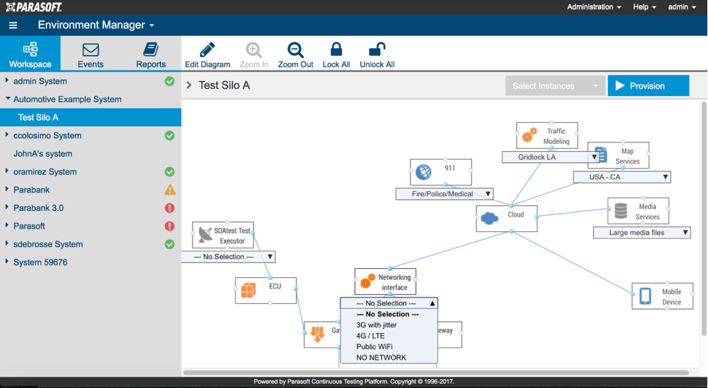
Virtual Test Bed
Service Virtualization
Simulated dev / test environment
Eliminate testing bottlenecks
Test real-world behavior beyond mocks and stubs
Test anytime, anywhere
Full control of the behavior; functional, data, performance, network
Locally on the desktop + shared server environments
Dynamically reconfigure via thin-client + automation workflows
Leverage Azure/AWS for on-demand scaling

Slide 26
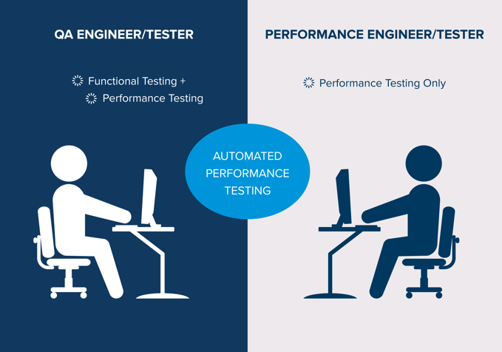
Test at scale with no hardware
Performance problems found late in the cycle costly to fix
Time between defect introduction and detection = too great
Non-functional requirement … not the focus of a ‘sprint’
Challenge
Disconnect between functional and performance tests
Infrastructure unavailable or not scalable
Solution
Reuse functional tests
Service virtualize the ‘performance characteristics’
Continuously validate the non-functional requirement

Slide 27
Amazon Alexa demo

Slide 28
Service virtualization for IoT

Slide 29
Summary
Learn from IT industry
Automated API Testing – stable, maintainable
Agile development – predictability of delivery
Service Virtualization – virtual test bed
Automated Security Testing – ‘detection’ drives ‘prevention’
Learn from Safety Critical and Embedded
Standards
Prevention Vs Detection
Testing in Isolation (Unit/Component)
Test, Requirement and Code Traceability – know what gets impacted by change
Learn from and apply strategies to tame the complexity explosion of embedded systems

Slide 30
THANK YOU Q&A
Andrey Madan
andrey.madan@parasoft.com

